Slide 1
Mail Prep & Entry
Pre-MTAC Webinar
February 15, 2018

Slide 2
Agenda
Delivery Operations
FAST Update
Question/Answer Period
Closing

Slide 3
Delivery Operations
August 23, 2017

Slide 4
Undeliverable as Addressed and Return to Sender Process
Reasons for UAA and RTS
There are 25 reasons in the DMM for returning mail to the sender (DMM 507.1.4.1)
Most common reasons are
Addressing issues
Missing or incorrect components
Addressee (name) issues
Does not reside at address
Most obscure
Violation of Postal False Representation and Lottery Law
Percent of total packages returned UAA
.03%

Slide 5
Undeliverable as Addressed and Return to Sender Process
UAA Process
Mail piece is identified as UAA by USPS employee
Employee endorses the mail piece with reason for the return
Some pieces are all endorsed individually
Deceased, Refused, No Mail Receptacle, others
For some return categories only the top piece of a group of like pieces are endorsed and bundled
Attempted Not Known, No Such Number, Insufficient Address, others
Employee provides mail to a specialized clerk who groups mail from multiple employees by reason for return
Uses specialized divider cards that contain each endorsement
Mail is sent to a centralized processing facility for Postal Automated Redirect System (PARS) processing
Automated equipment reads the separator card, applies a label with the return reason and a barcode with the return address for all following pieces until the next card is detected
Mail is then processed with other outbound mail
Parcels are endorsed similarly but may also receive a scan from the carrier
The specialized clerk will make a more specific scan with the reason for the return
Manually prepares the package for return or forwarding and place with other outbound parcels
Undeliverable as Addressed

Slide 6


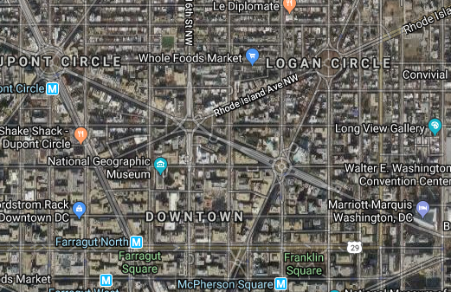
Weighted Undeliverable as Addressed and Delivered
Scanned UAA and Delivered to Same Address
Week 16 FY18
SATURDAY | 10.1%
SUNDAY | 3.2%
MONDAY | 15.4%
TUESDAY | 22.3%
WEDNESDAY | 17.1%
THURSDAY | 16.7%
FRIDAY | 15.2%
Unfamiliar carriers sometimes cannot find an address in complex urban environments, or the customer does not have a house number so they return the piece to the post office and to obtain instructions for delivery
City Carrier | 53.4%
Rural Carrier | 28.6%
Clerk | 10.3%
Small errors in the address will cause a carrier unfamiliar with the route to return a piece to the post office to allow a carrier experienced on the route to correct the error rather then return the package

Slide 7
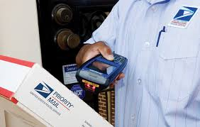
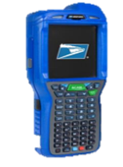
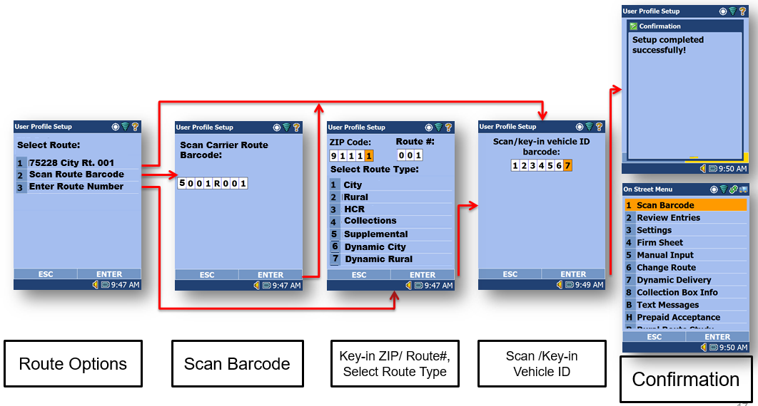
Reducing Scanning Errors
Mobile Delivery Device Menu Redesign
Simplify and Consolidate
Categorize into five broad selections
Delivered
Attempted
Return to Sender or Forward
Ancillary
Other
Allow carrier to select specific reason for returns
Improve login process to ensure
Correct carrier information
Correct route information

Slide 8
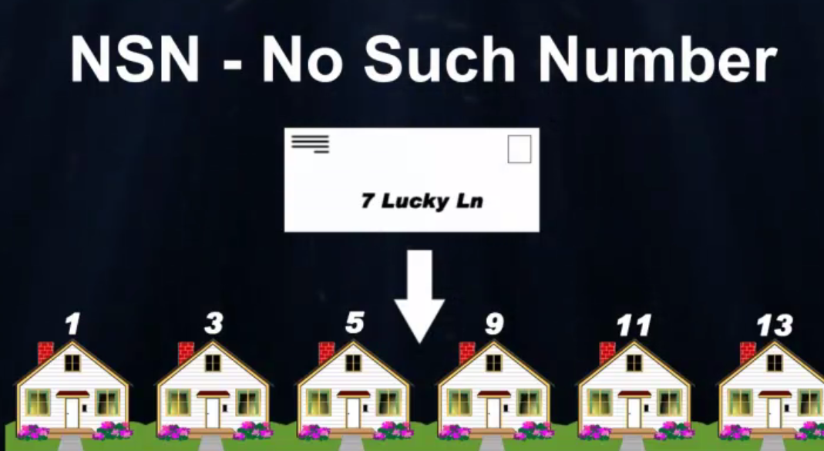
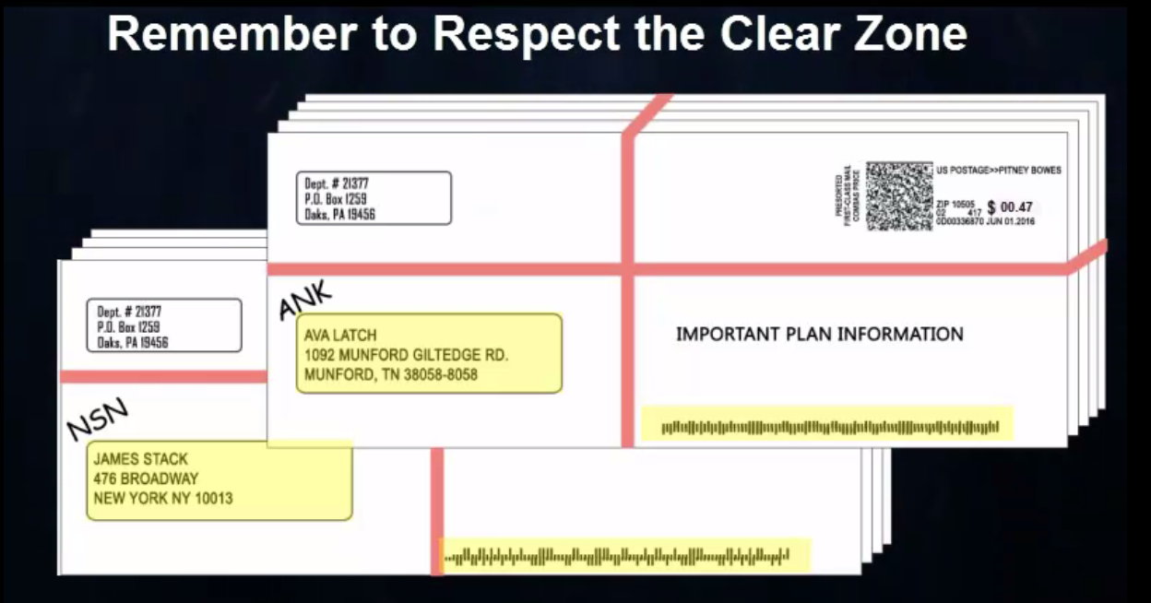
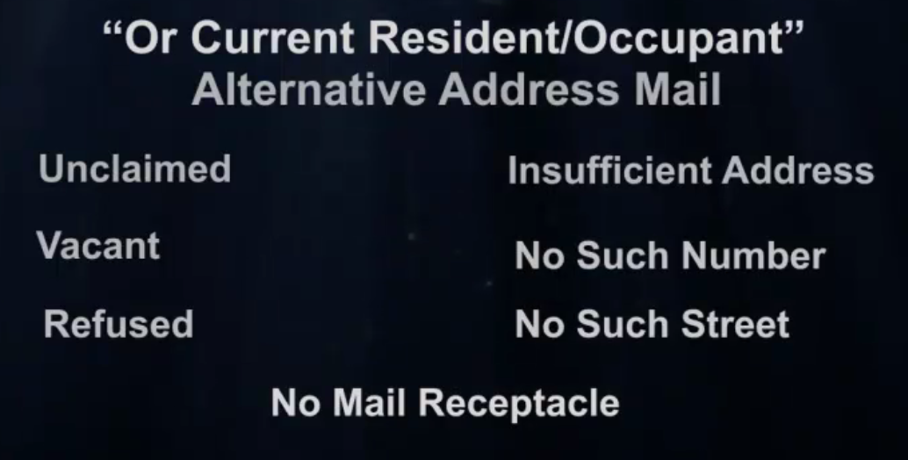
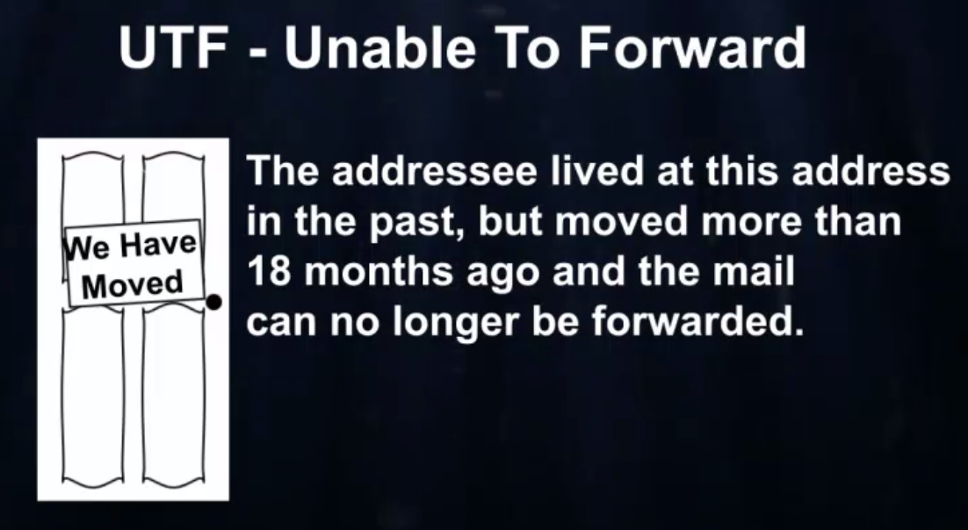
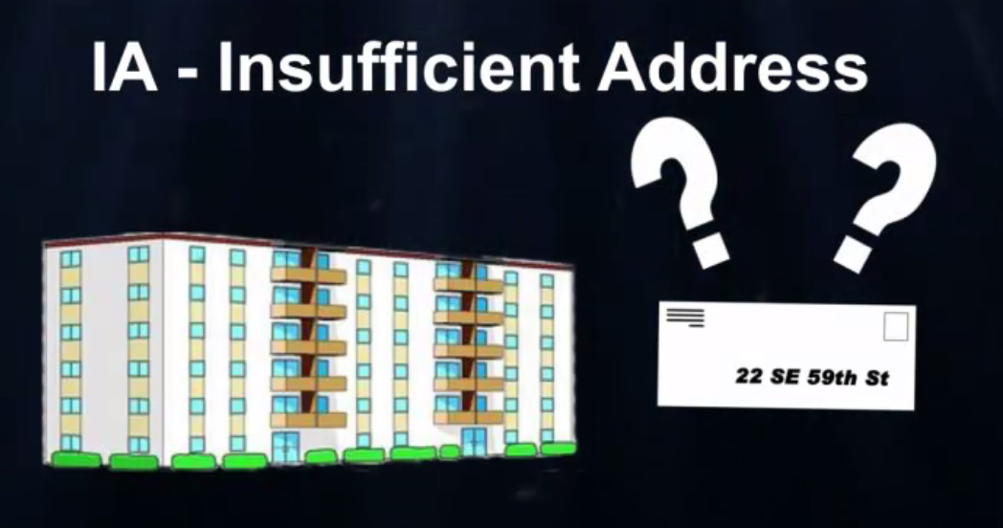
Training Initiatives
Finalizing clerk, carrier training video for UAA
Addresses several key mailer concerns
Mail returned in error
Mail returned with wrong endorsement
Barcode obliteration

Slide 9
3M – Missent, Missort and Missequence
3M Errors
3M errors occur in automated mail processing
Letter & Flat Delivery Point Sequencing
Root causes:
Machine jams
Machine stops
Double feeds
Bad barcodes
Glare
Delivery looks for recurrent errors / Feedback process to mail processing
Mail Processing has some early warning tools for Delivery

Slide 10
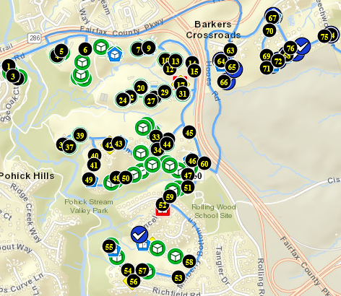
Dynamic Routing
USPS ingests package data
Delivery controls & decides level/scope of routing needed
Groups of ZIP Codes
Fixed Groups of Routes
Sections of Routes
Delivery unit submits selected areas and/or packages for routing
USPS software routes packages
Delivery unit receives “routing complete” message
Distribution clerks scan packages AAU and receives dynamic route number and delivery order (sequence number)
Carrier receives sequence and directions via the Mobile Delivery Device
Audio and on-screen
Paper back-up available

Slide 11
Summary
Summary
USPS shares your concerns with errant Undeliverable As Addressed returns
Letters, Flats, Parcels
Working to improve via education, technology, scanning
USPS has expanded dynamic routing from Sunday only to all days of the week
True dynamic, Static dynamic, volume based dynamic, street density level dynamic
Working to include fixed scheduled points (time of day)with unscheduled points
Collection points, package delivery, custom delivery, USPS relays
Improve the customer experience and improve efficiencies

Slide 12
FAST
August 23, 2017

Slide 13


FAST Help Desk
The following charts relate to calls and emails from mailers to the FAST Helpdesk over Dec 2017 - Jan 2018
3,906
Emails
7,766
Calls

Slide 14
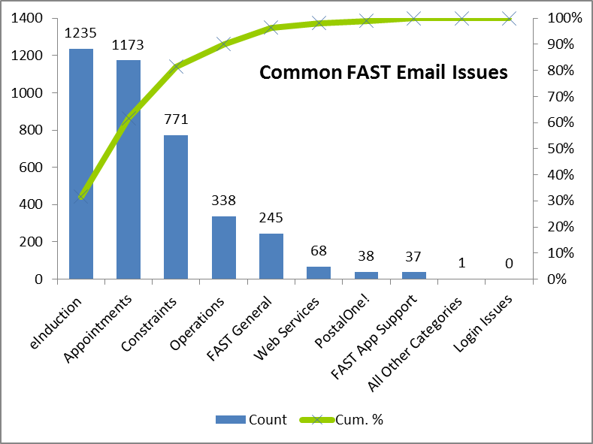
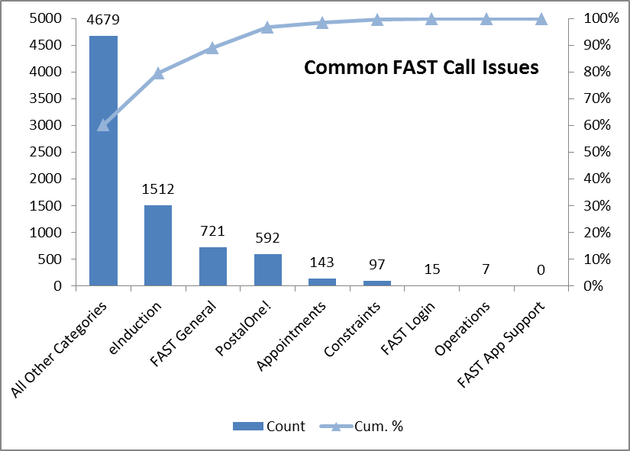
FAST Help Desk
Dec 2017 – Jan 2018
Emails
Calls
Help Desk Hours | Call Count | %
Business Hours (Mon-Fri, 7AM-7PM CT) | 7,291 | 93.9%
On Call Hours (7PM-7AM CT & wknds) | 475 | 6.1%
Total | 7,766 | 100.0%

Slide 15
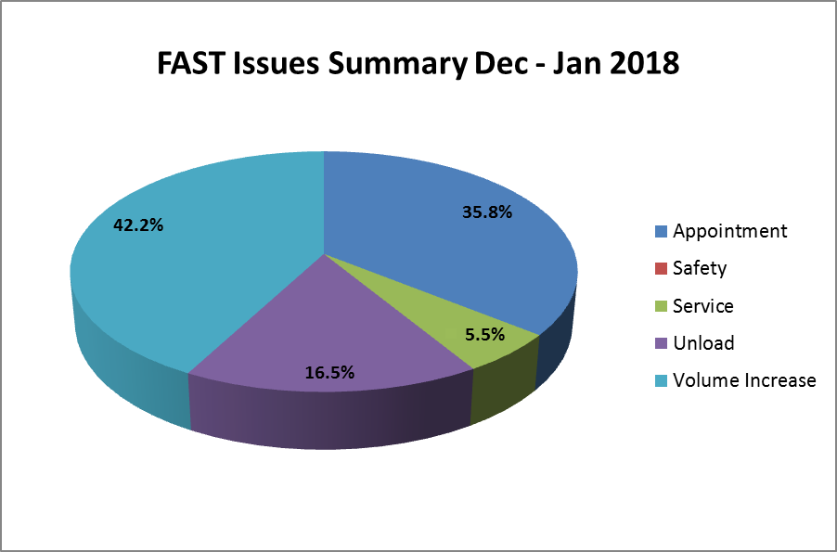
FAST Help Desk – FAST Issues

Slide 16
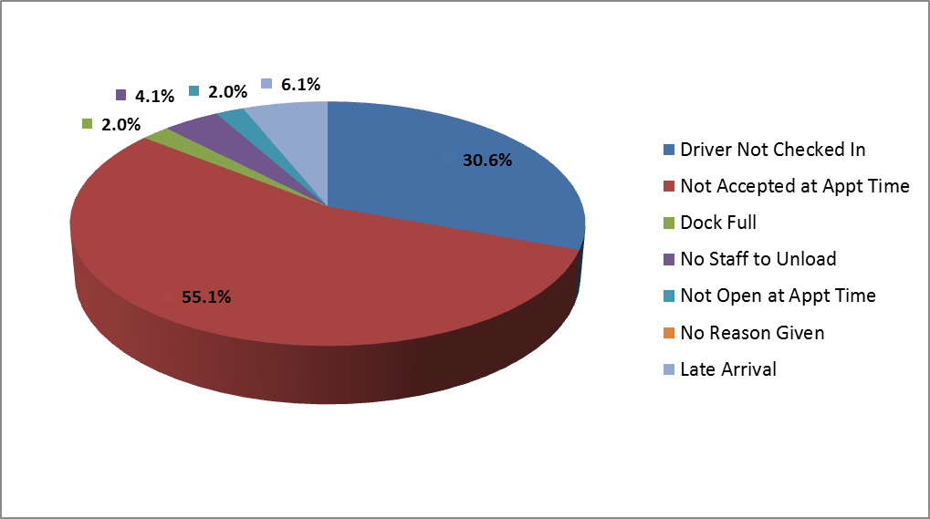
FAST Help Desk – Unloads
Unload Issues, Dec 2017 – Jan 2018

Slide 17
Planned Improvements
Verify facility profiles nationally, including names, email addresses, phone numbers, hours of operation, drop ship hours, etc. [Feb 2018]
Notify managers/employees of FAST issues [Feb 2018]
Develop internal drop shipment dashboard [April 2018]
Provide employee training/communications on common FAST issues [ongoing]

Slide 18

Questions

